Slide 1

Invoke-Explosion
Combining the day jobs can lead to explosive results

Slide 2

Who am I
Leo D’Arcy
Senior Consultant
PowerON Platforms

Slide 3
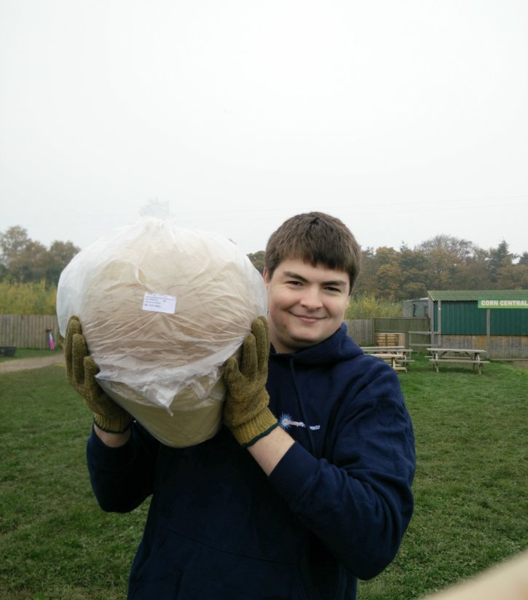
Who am I
Pyrotechnician

Slide 4
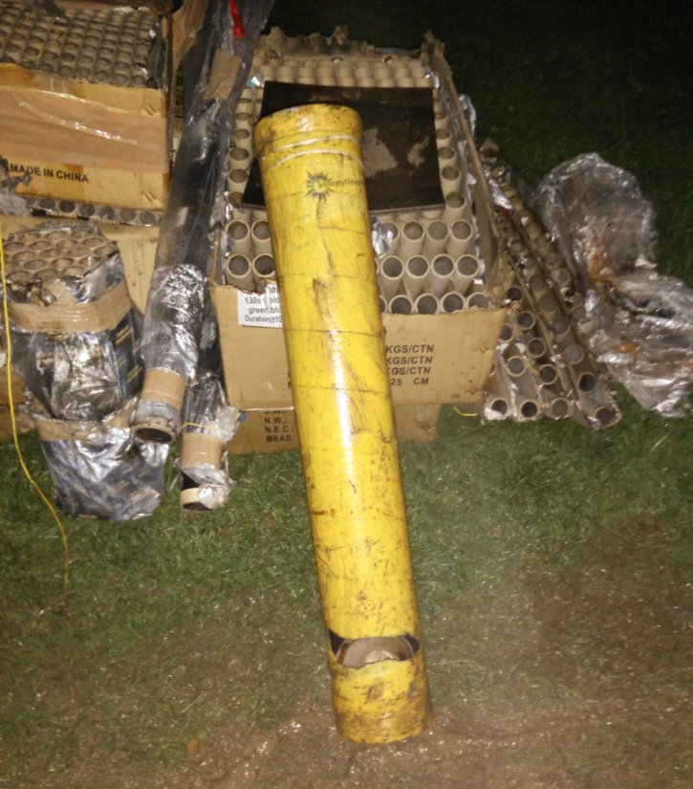
Disclaimer
Don’t try this at home!

Slide 5
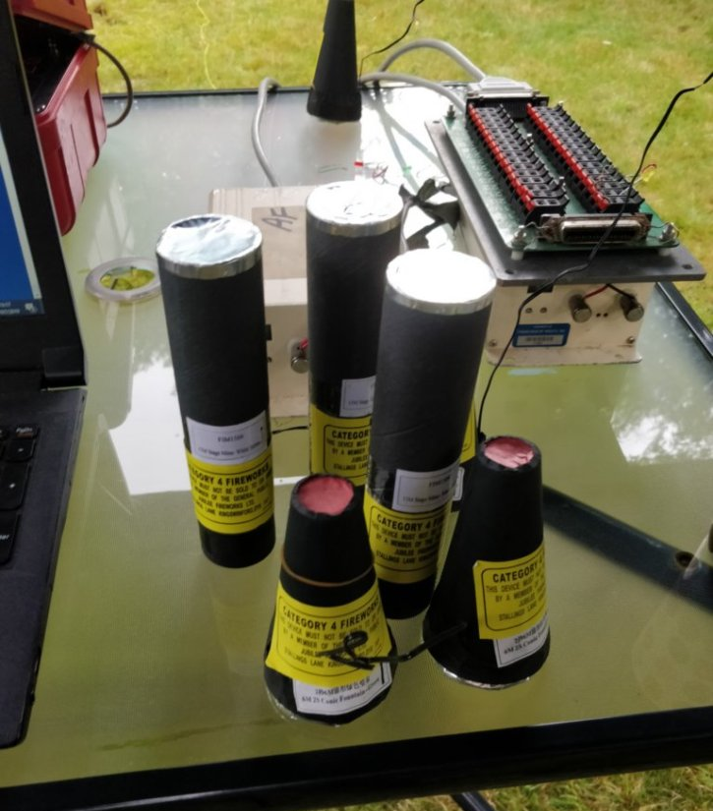
Fireworks

Slide 6
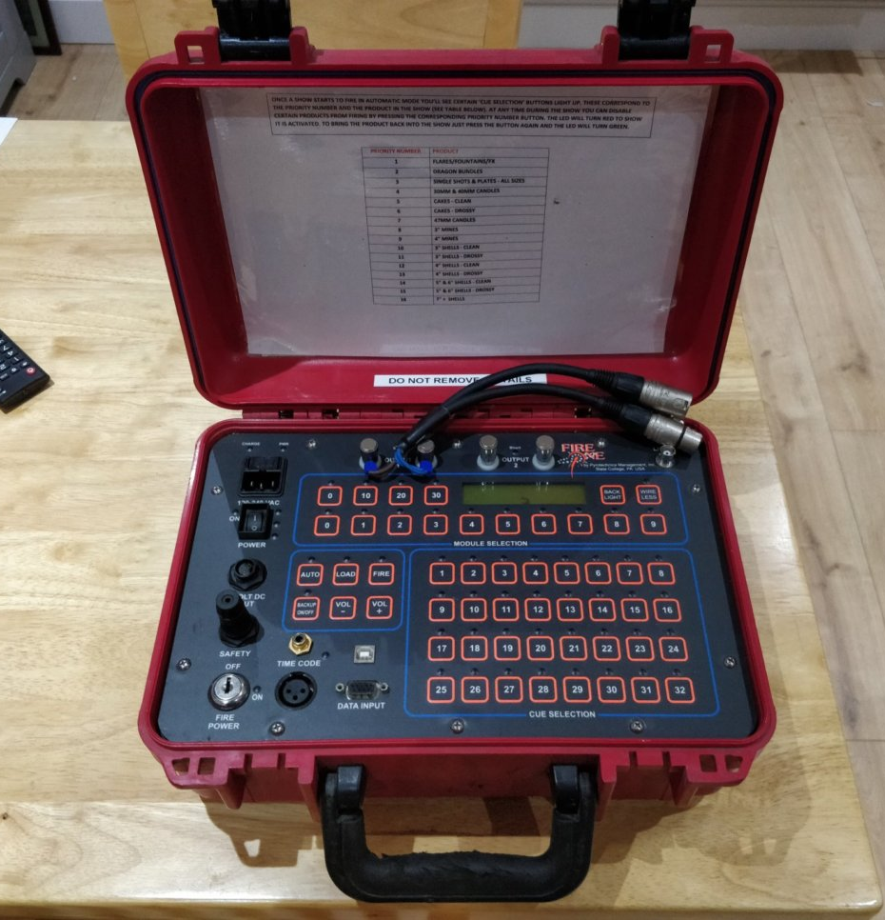
FireOne
Developed by Pyrotechnics Management, Inc
Used for big and small shows alike
New Years Eve, London
Super Bowl Halftime Show
New Years Eve, UAE (Guinness World Record for longest change of Fireworks)
Royal Wedding

Slide 7
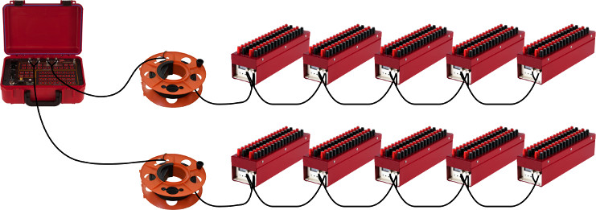
How it works
© 2018 Pyrotechnics Management, Inc. http://www.fireone.com/examples/

Slide 8
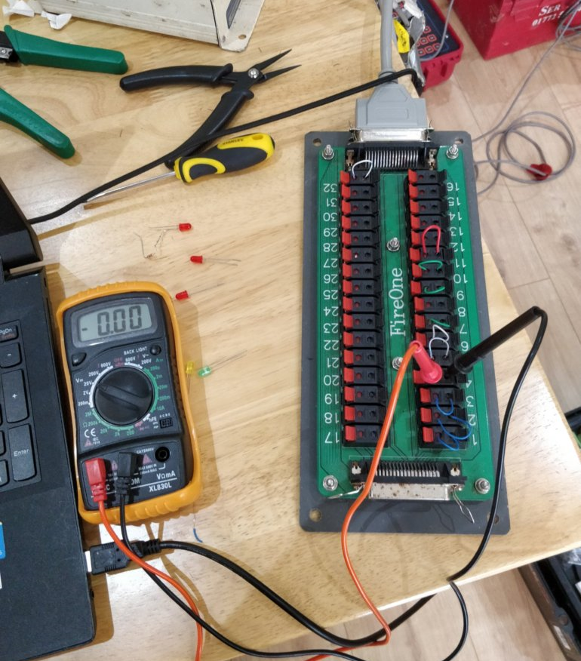
Module Output
Nearly 20V
Nearly 5A

Slide 9
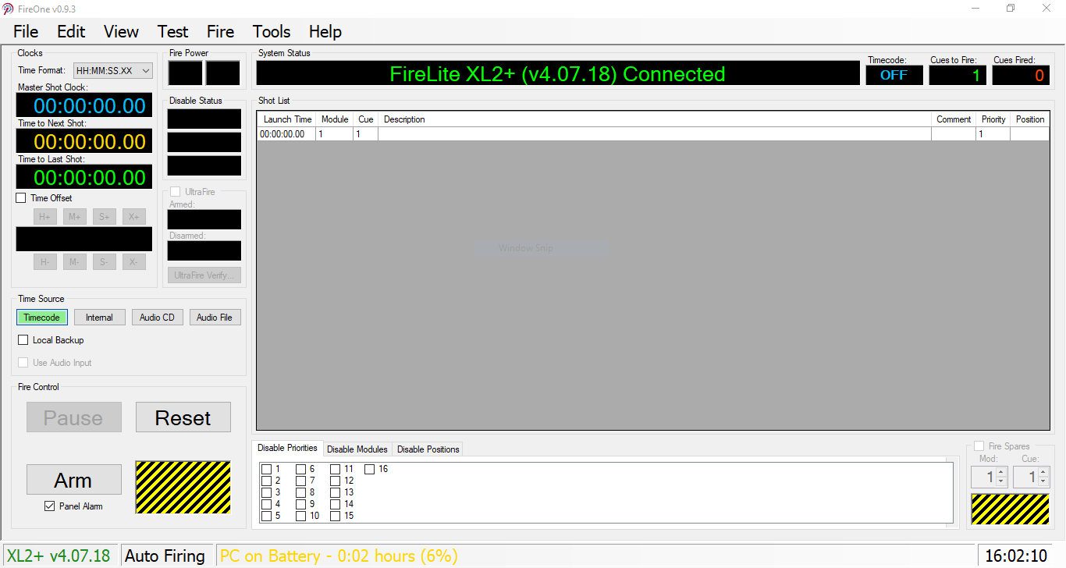

Slide 10
Hardware
Laptop
Muiltimeter
Yoctopuce
Oscilloscope

Slide 11
Software
UltraFire
Yocto-Snoop
Serial Port Monitor

Slide 12
Module Design
Build-Module
Public
Private
Global
PSFramework
Serial Configuration
GitHub
Private Reposetory

Slide 13
Checksum
Not Publicly Disclosed
No Standard for serial connection checksums
Trial and Error to identify Exclusive Or used

Slide 14
Checksum
$CheckSum = 0
foreach ($item in $Data)
{
$CheckSum = $CheckSum -bxor $item
}

Slide 15
Invoke-Show Walkthrough

Slide 16
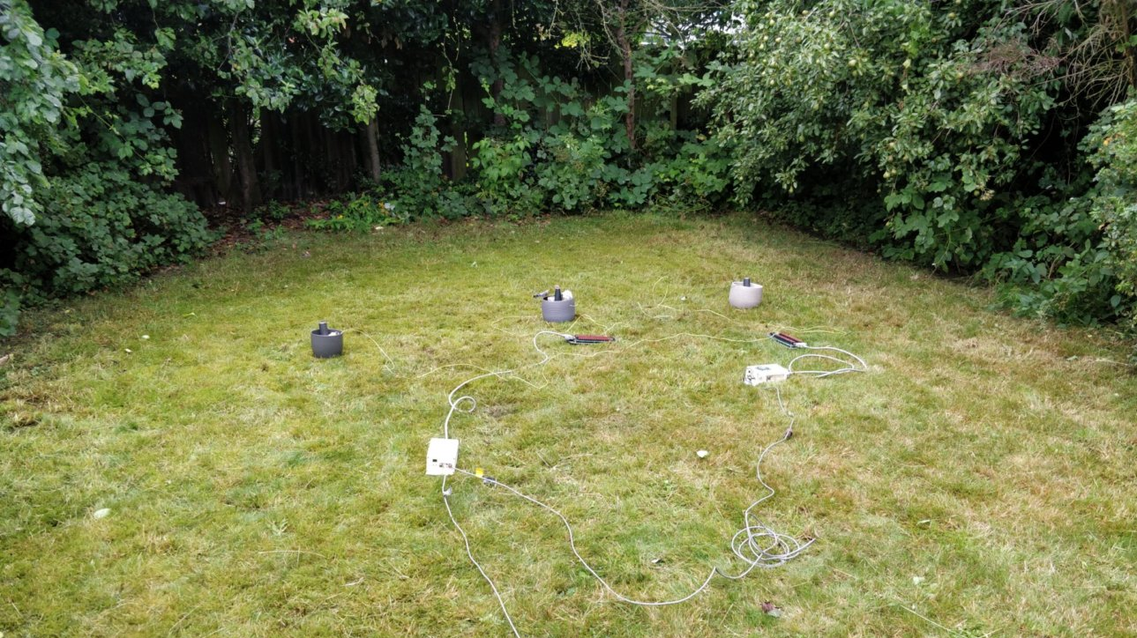

Slide 17
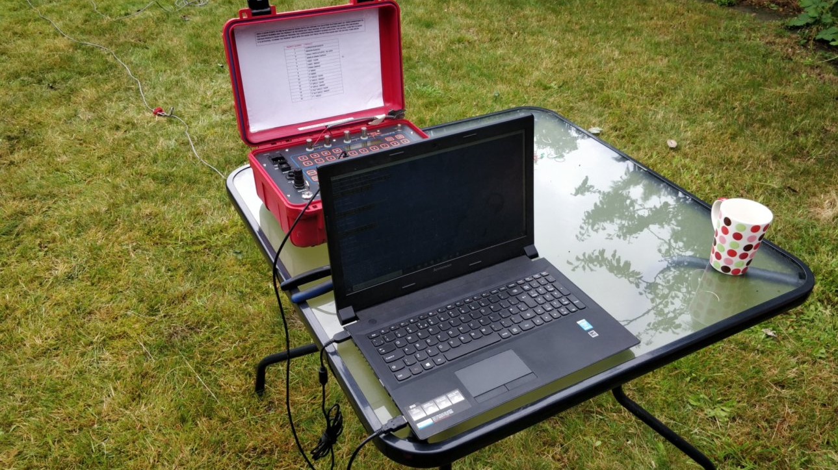

Slide 18
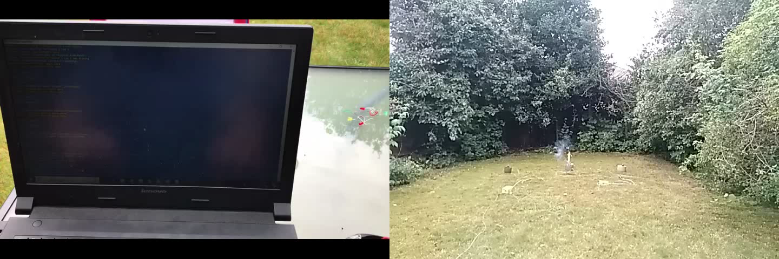

Slide 19
Tips
Stop thinking in decimal
Find patterns

Slide 20
Data Consistency
Be very careful about only looking for specific bytes, what happens if a different byte is changed unexpectedly?
Be extremely careful about fail states (Fail false or fail true?)
Are you only testing on a single device / model? What happens if that changes?
What happens if the checksum fails?
What happens if the device sends back old data (it can’t keep up?)

Slide 21
This project was a bad idea

Slide 22
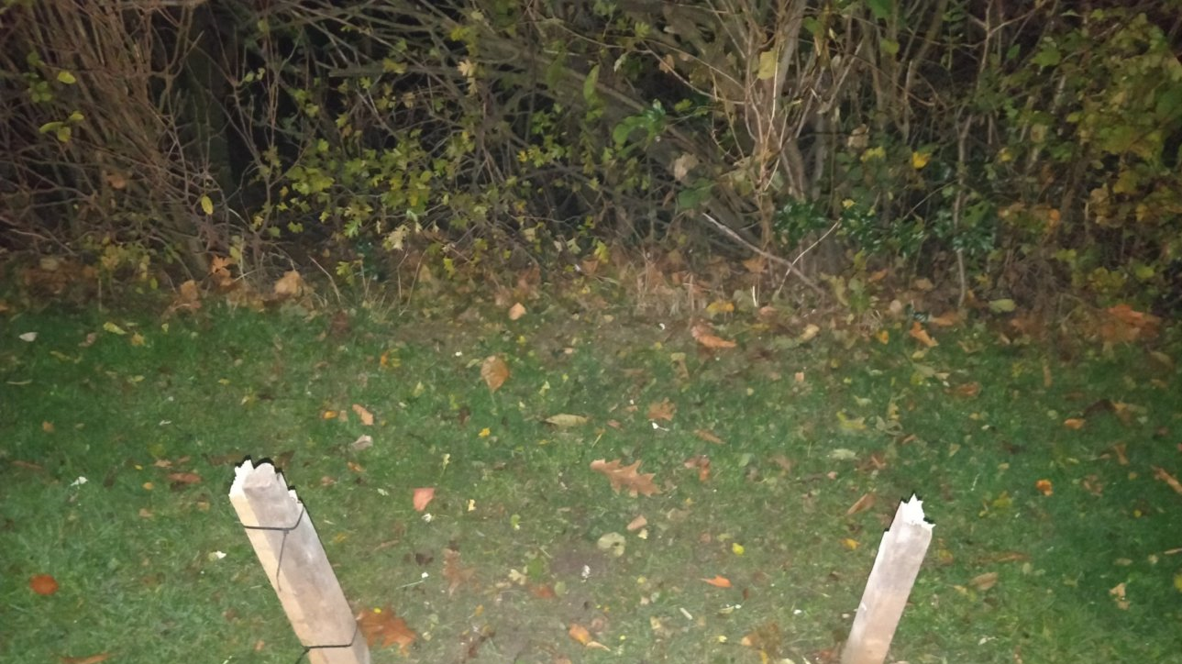
Thanks
Any questions?
You can find me at
@LeoDarcy1
leo.darcy@outlook.com

